Slide 1
Analyzing Amazon Sales data
Data Analytics Project

Slide 2
Introduction
Sales management has gained importance to meet increasing competition and the
need for improved methods of distribution to reduce cost and to increase profits. Sales
management today is the most important function in a commercial and business
enterprise.
Do ETL: Extract-Transform-Load some Amazon dataset and find for me
Sales-trend -> month-wise, year-wise, yearly_month-wise
Find key metrics and factors and show the meaningful relationships between
attributes. Do your own research and come up with your findings.

Slide 3
Details of Data
2011
January
February
March
April
May
June
July
August
September
October
November
December
2012
2013
Country
Region
Order by Date
Distribution of Items
Mode of Purchasing
2014
2015
2016
2017

Slide 4
Main KPIs
Years
Months
Mode of Purchasing
Distribution of items by Regions
Items Sold in Various Regions
Order Priority By Year
Total Profit By Year
Region
Country

Slide 5
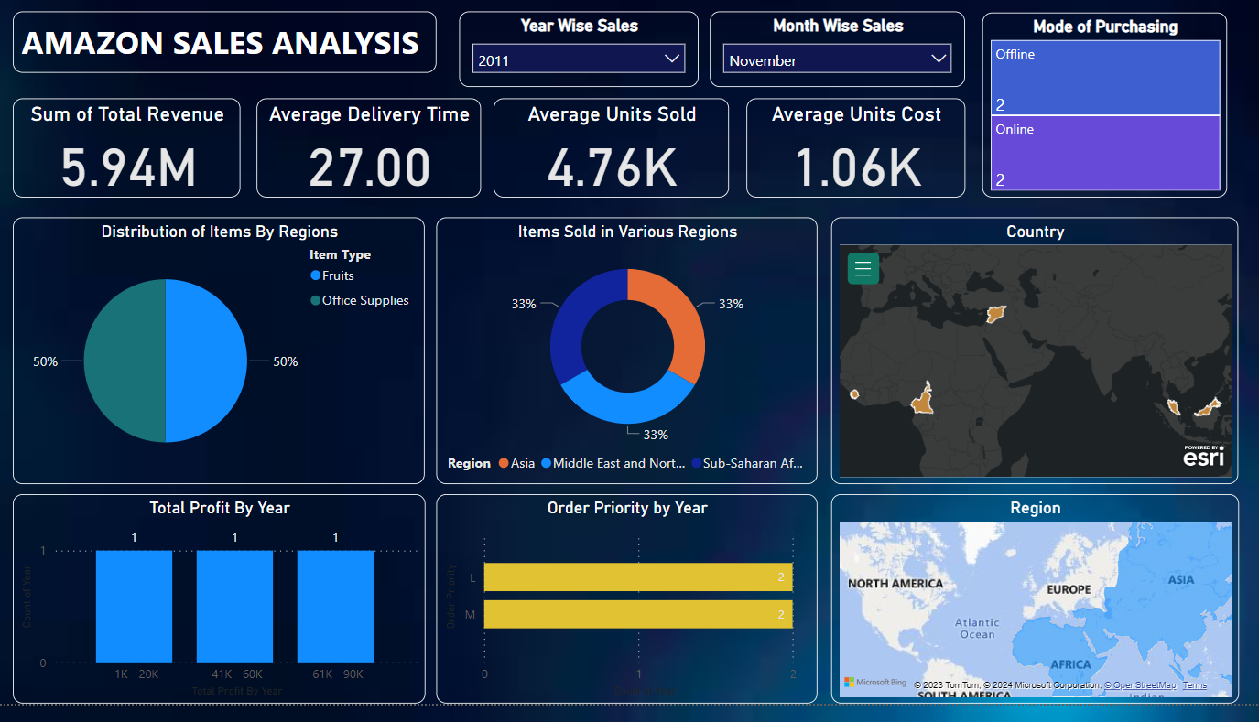
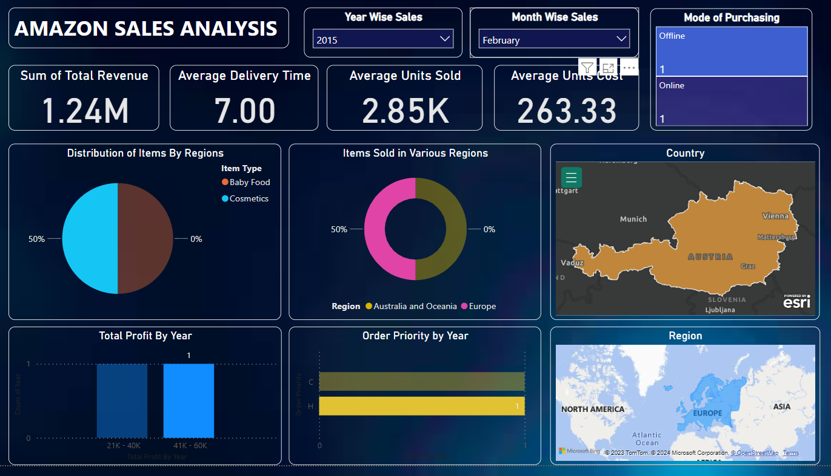
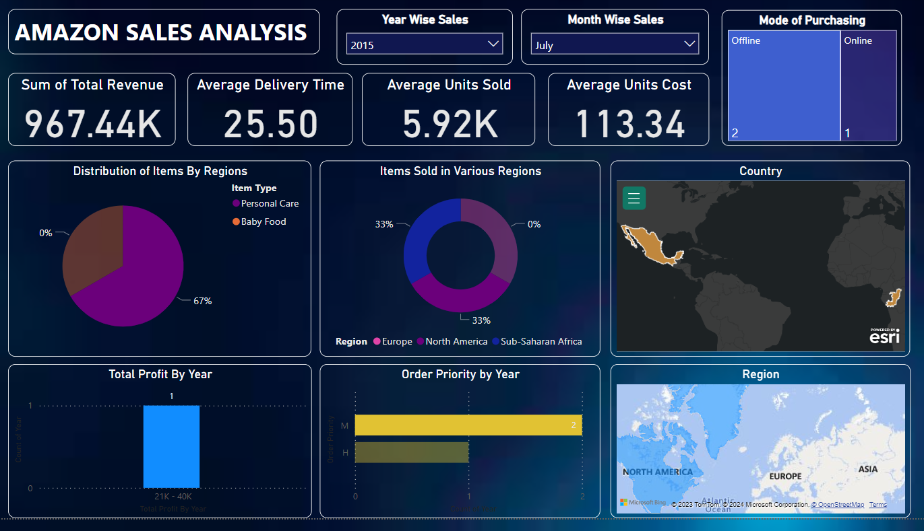
My Design

Slide 6
Thank you

